Slide 1


Solution submission by <TEAM NAME>
Note: This is a reference Slide. Add as many details as you want. (New PPT should be created)

Slide 2

MEET THE TEAM
Your Name
Your Name
Your Name
Your Name
Your Name
About You
About You
About You
About You
About You

Slide 3


Copy It from your IDEA Submission
Problem Statement
Manual medical image analysis causes diagnostic delays
Problem Statement Expansion
Manual medical image analysis creates significant diagnostic bottlenecks, leading to delayed treatments and increased clinician burnout. By the start of 2026, healthcare providers are increasingly adopting AI to automate anomaly detection, ensuring faster, more accurate results that improve patient survival rates and efficiency
How it manifests for the user or client
SAMPLE for reference, please replace with your project details
Manual medical image analysis creates significant diagnostic bottlenecks, leading to delayed treatments and increased clinician burnout. By the start of 2026, healthcare providers are increasingly adopting AI to automate anomaly detection, ensuring faster, more accurate results that improve patient survival rates and efficiency
PROBLEM STATEMENT
How it impacts the user or client
In 2026, diagnostic delays cause irreversible health decline and massive financial loss for patients. For clinicians, the resulting workload triggers 80%+ burnout rates and fatigue-driven errors, compromising safety and forcing healthcare systems into a reactive, high-cost cycle of crisis management.
Note: This is just a sample for your understanding. Change it as per your details. Don’t change the header.

Slide 4


Copy the Persona for whom you are making the solution
USER PERSONA 1
ABOUT THE USER
ABOUT THE USER
Derek is a confident graphic designer who runs his own freelance business. He works with writers, photographers, and other creative professionals to deliver captivating designs to clients. Derek dreams of growing his solopreneur venture into a design agency.
Down-to-earth
Easy-going
Reliable
Inspiring
Problem solver
SAMPLE for reference, please replace with your project details
PROBLEMS
GOALS AND NEEDS
DEREK
Presenting his work to a wider audience
Expressing his ideas in words
Keeping his designs and freelancing business relevant
To express his creativity and vision to others
To develop a successful freelance business
To find inspiration from the world around him
28 years old
Salguerro
Designer
$45,000 - $139,999
CHALLENGES
Following up with clients on feedback
Billing clients on time
Managing his notes, clippings, and resources

Slide 5




Copy It from your IDEA Submission
Solution Details
Solution Name (Try to keep it under 5 words)
Describe your solution (Try to keep under 100 words)
Demographic it Impacts

Slide 6
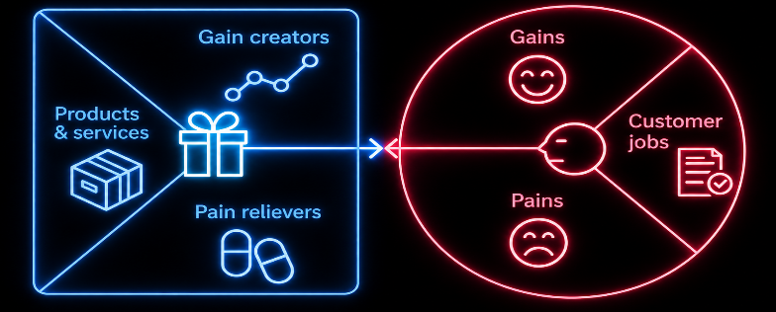
Value proposition
In solution clearly indicate what is in your solution right now or what is future state
These are features or benefits that help customers achieve positive outcomes, exceed expectations, or feel delighted.
These are the tasks, problems, or goals customers are trying to accomplish.
These are the actual offerings your company provides to customers.
These are the benefits customers want or expect.
These address customer challenges, risks, or barriers.
These are negative emotions, costs, risks, or frustrations customers experience.

Slide 7
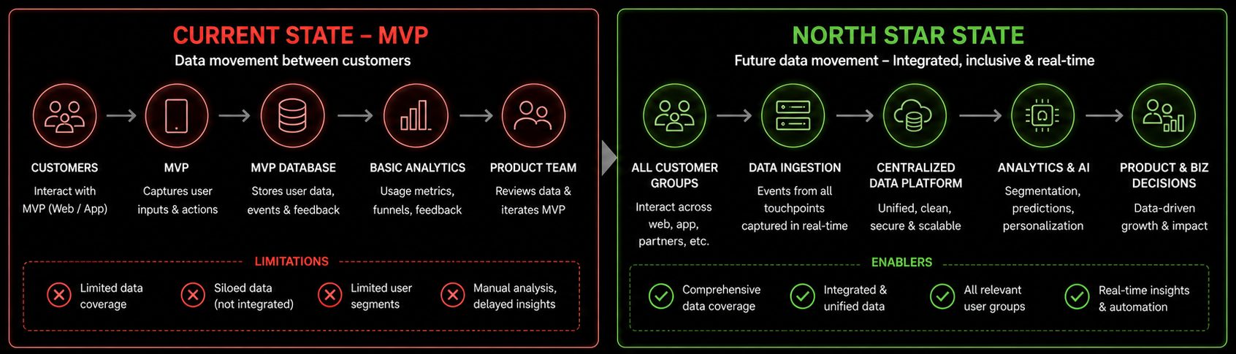
Thinking BIG
Current State vs Future State of our solution
SAMPLE for reference, please replace with your project details

Slide 8
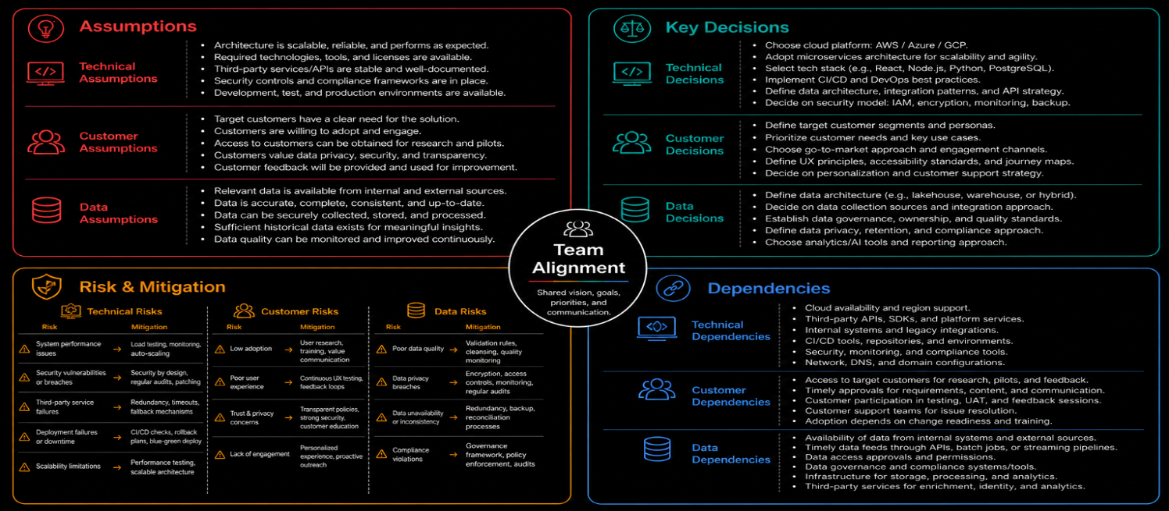
Architecture Discovery

Slide 9
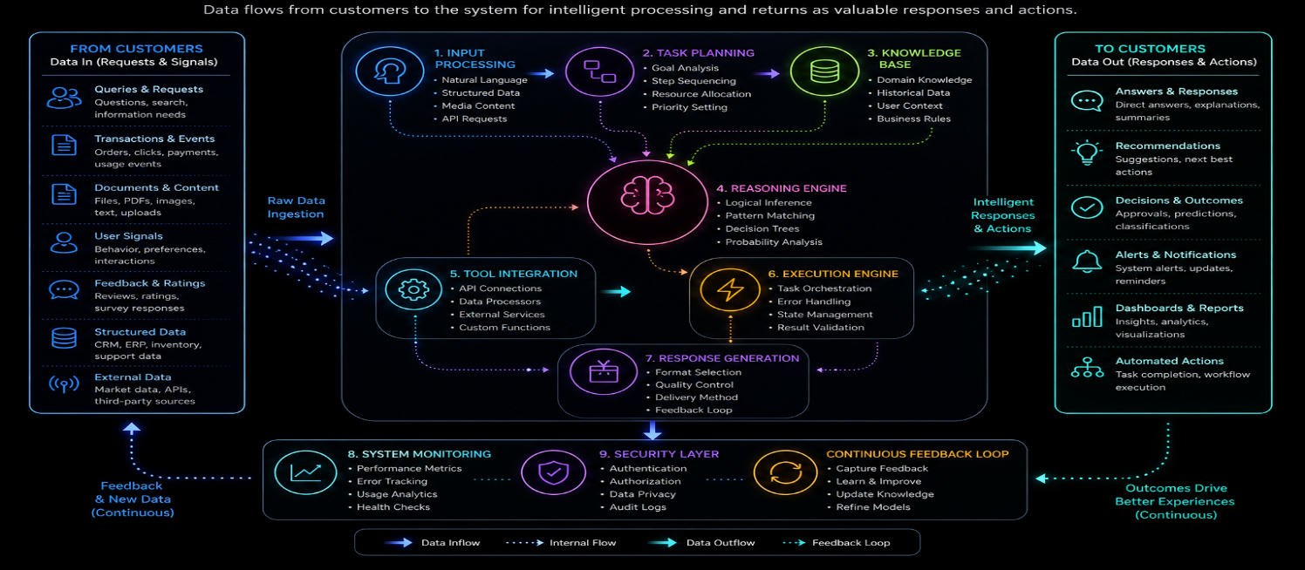
Process & Data Flow
Provide a perspective on your current state solution versus how it will evolve to a future state
You can use a simplified version of the Process and Data Flow visual
SAMPLE for reference, please replace with your project details

Slide 10
Rollout Roadmap
How will your Current State Solution evolve to a
Future Powerful Solution?
Provide a stagewise roadmap on the evolution highlighting additional features as they could be added and value they will add to the solution
Note: A rollout roadmap sample is available in appendix. You can use that version or a simpler depiction (your choice)

Slide 11
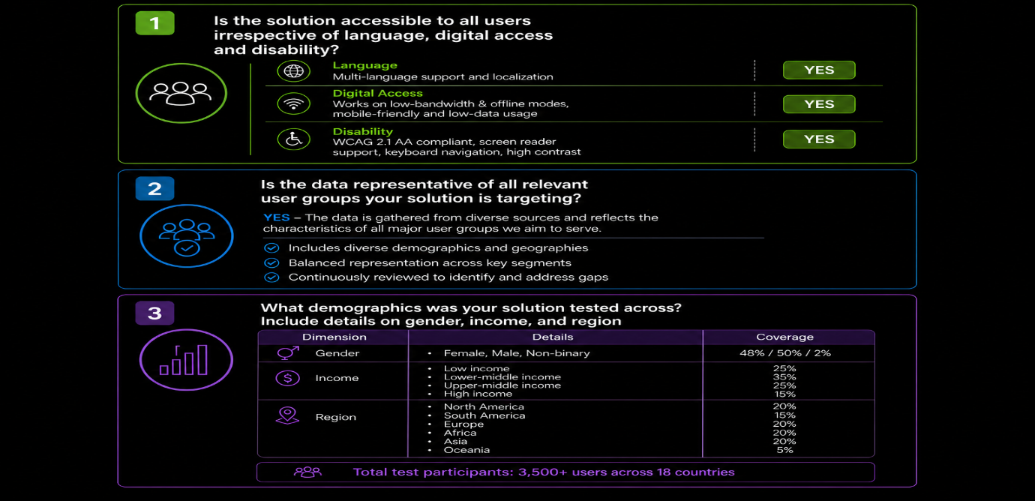
Solution Inclusivity, Fairness and Explainability (1/2)
SAMPLE for reference, please replace with your project details

Slide 12
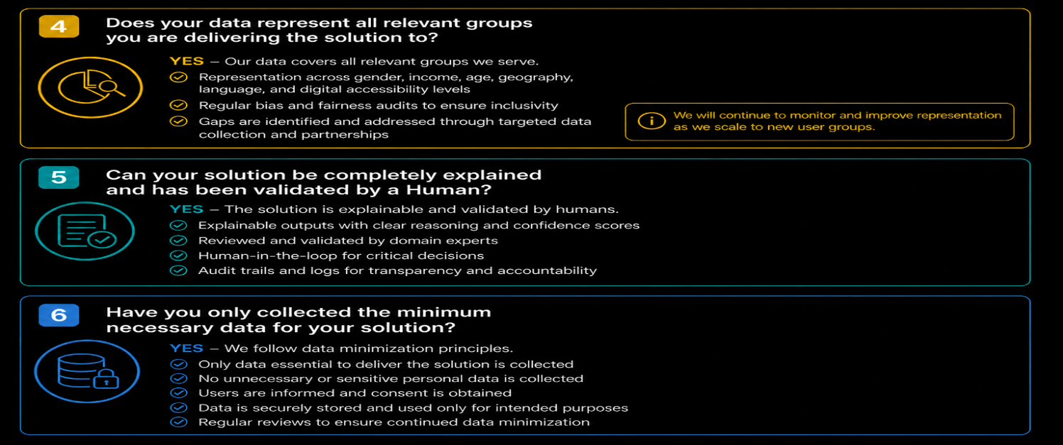
Solution Inclusivity, Fairness and Explainability (2/2)
SAMPLE for reference, please replace with your project details

Slide 13
Actual Solution Images/ Videos
Add the images or the video of your application to show how it works :- Link only

Slide 14

THANK YOU
And all the best for your solution judging

Slide 15
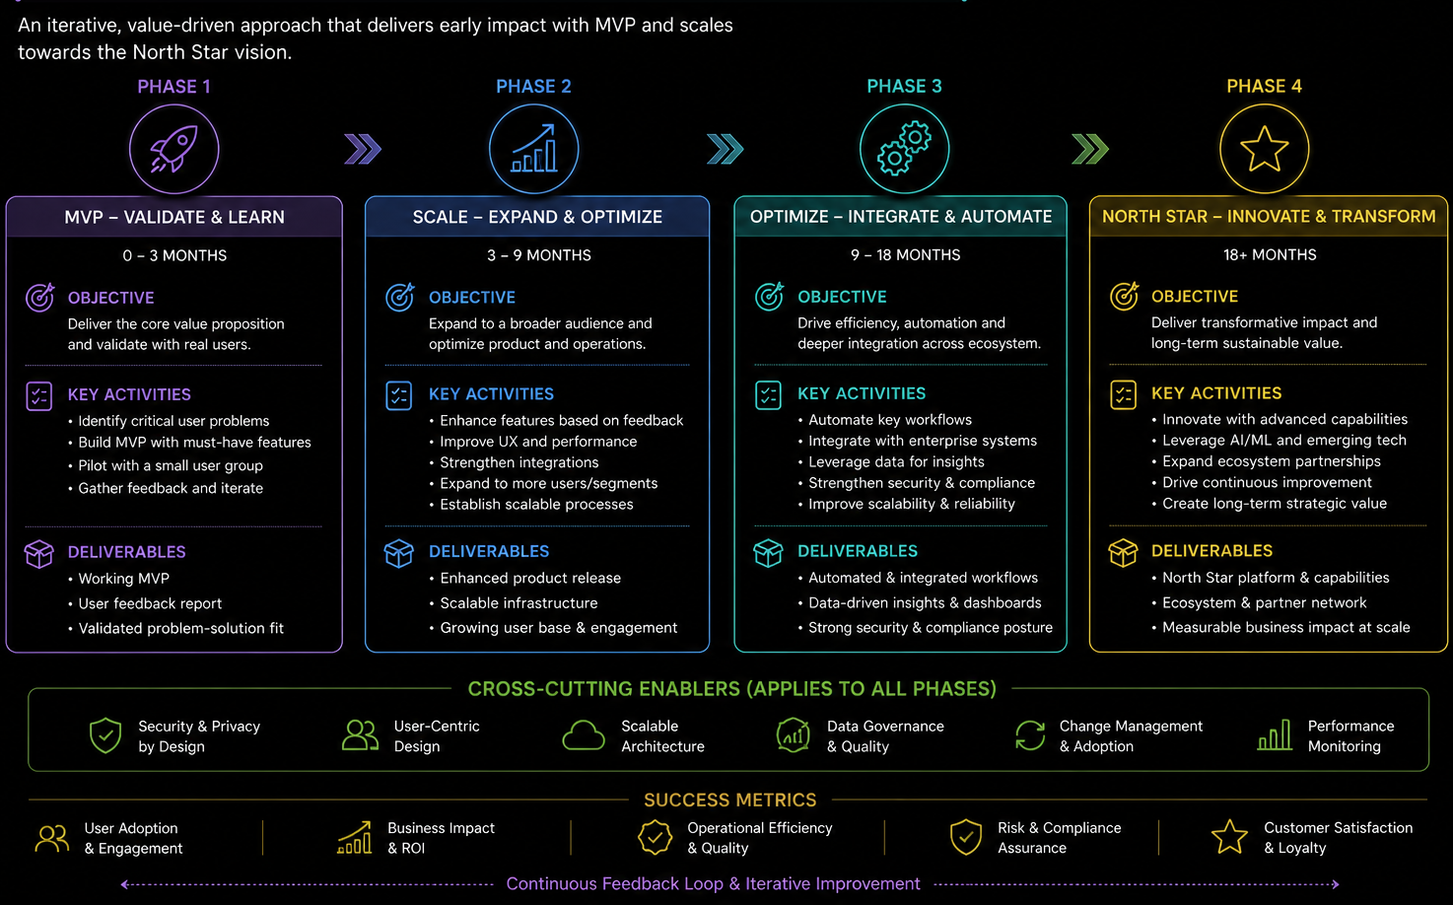
Rollout Roadmap – A Sample
SAMPLE for reference, please replace with your project details

